Slide 1
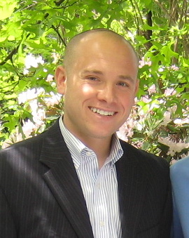
Boston District
Has been highlighted by Account Manager as helping grow Humalog SOM on top plans over the past few months
Passionate about helping physicians understand the importance of post prandial glucose control in their patients.
Collaborative team member with an active voice who excels at sharing best practices through team voicemails.
Northeast Humalog Rep of the Month
Mike Norcia

